Slide 1
Serializability

Slide 2
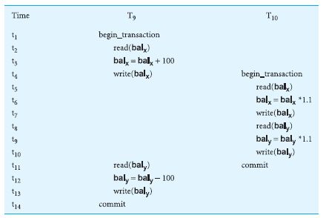

Slide 3
View serializability
A mechanism to ensure that result of serial and concurrent execution is same. If not, then their order of execution is changed in such a way to avoid conflict by replacing empty instructions by a stall.

Slide 4
Concurrency control techniques
Locking
Timestamping

Slide 5
Locking
A procedure used to control concurrent access to data. When one transaction is accessing the database, a lock may deny access to other transactions to prevent incorrect results

Slide 6
Time stamping
In timestamping, each transaction is assigned a time stamp which has some expiry time.
The timestamps can be assigned using increasing integers or using the system's clock. During the execution of transactions, the DBMS checks the timestamps of conflicting operations and determines their execution order.

Slide 7
Types of Locks
Shared lock
If a transaction has a shared lock on a data item, it can read the item but not update it. Multiple transactions can access the data item.
Exclusive lock
If a transaction has an exclusive lock on a data item, it can both read and update the item. Only single transaction can access the data item.

Slide 8
Two-phase locking (2PL)
A transaction follows the two-phase locking protocol if all locking operations precede the first unlock operation in the transaction.
Growing phase
Shrinking phase

Slide 9
Cont.
Growing phase(1st phase): All the necessary locks are acquired for the transaction may be shared or exclusive
Shrinking phase(2nd phase): All the locks are released after applying the required procedure.

Slide 10
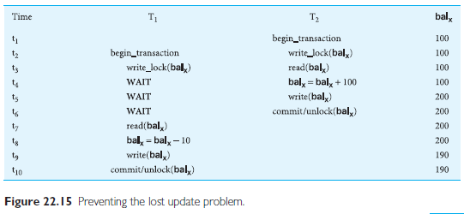

Slide 11
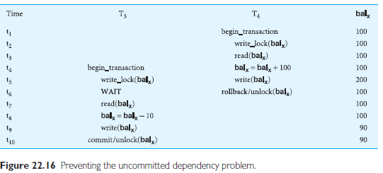

Slide 12
Preventing the inconsistent analysis problem.
Consult your text book for reading.

Slide 13
Deadlock
Chapter 22

Slide 14
Deadlock
An impasse that may result when two (or more) transactions are
each waiting for locks to be released that are held by the each other.
Solution:
1) Timestamping ( it will release the transaction after its expiry)
2) Serializability
3) Bankers’ Algorithm
4) Draw a graph and detect cycle and try to remove it by changing order of instructions

Slide 15
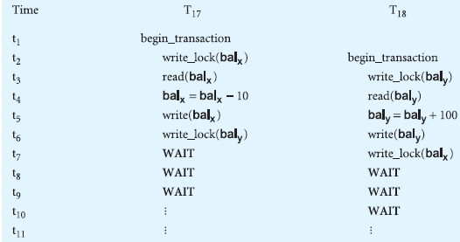

Slide 16
How to handle Deadlock
Timeout
Deadlock Prevention
Deadlock Detection and Recovery

Slide 17
Database Recovery
Chapter 22

Slide 18
Database Recovery
The process of restoring the database to a correct state in the event
of a failure.

Slide 19
The Storage Medium
The storage of data generally includes four different types of media
1. Main memory
2. Magnetic disk
3. Magnetic tape
4. Optical Disk
Primary storage
Secondary Storage
RAID (Redundant Array of Independent Disks)

Slide 20
Causes of failure
• System crashes due to hardware or software errors, resulting in loss of main
memory;
• Media failures, such as head crashes or unreadable media, resulting in the loss
of parts of secondary storage;
• Application software errors, such as logical errors in the program that is accessing
the database, that cause one or more transactions to fail;
• Natural physical disasters, such as fires, floods, earthquakes, or power failures;
• Carelessness or unintentional destruction of data or facilities by operators or
users;
• Sabotage, or intentional corruption or destruction of data, hardware, or software
facilities.

Slide 21
Transactions and Recovery
Transactions represent the basic unit of recovery in a database system
In failure, the recovery manager guarantee the Atomicity and Durability properties of transaction.

Slide 22
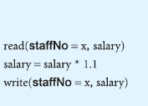
Transaction

Slide 23
Transaction steps
find the address of the disk block that contains the record with primary key
value x;
Transfer the disk block into a database buffer in main memory;
Copy the salary data from the database buffer into the variable salary.
For the write operation, the DBMS carries out the following steps:
Find the address of the disk block that contains the record with primary key
value x;
Transfer the disk block into a database buffer in main memory;
Copy the salary data from the variable salary into the database buffer;
Write the database buffer back to disk.

Slide 24
Database buffer
Database buffers: Occupy an area in main memory from which data is transferred to and from secondary storage.
When database buffers flushed, the updates are stored permanently on secondary storage.
Buffers are flushed when its full or when a command is issued.
What? If a failure occurs between writing to the buffers and flushing the buffers to secondary storage .
The Recovery Manager resolve the issue.

Slide 25
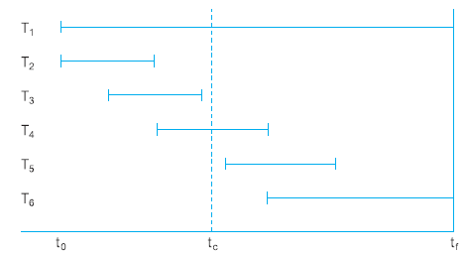

Slide 26
Granularity
The size of data loaded in main memory buffer.
1) Coarse: Large size data, getting full page table, file or database table
2) fine: Small size, getting only record from table, getting variable not entire block
Fine granularity is efficient but requires complex processing due to mapping of addresses

Slide 27
Buffer Management
Transfer pages to and from secondary storage
Replacement strategy
First in First out
Least recently used
Data already in buffer should not read from disk

Slide 28
Terminologies used in database recovery when pages are written back to disk:
Steal policy / No steal
Forcepolicy / No force

Slide 29
Cont.
The force policy is a buffer management strategy where modifications made to buffer pages are immediately written back to the disk. When a transaction updates a buffer page, the corresponding disk page is immediately updated as well. This ensures that the disk remains up-to-date with the latest changes, even before the transaction commits.
The steal policy is a buffer management strategy where dirty (modified) buffer pages can be written back to disk before the corresponding transaction commits. In this policy, buffer pages can be "stolen" from a transaction and written back to disk to make space in the buffer pool for other pages. The stealing occurs when the buffer pool is full and needs to accommodate more pages.

Slide 30
Recovery Facilities
A DBMS should provide the following facilities to assist with recovery:
Backup mechanism
Log file (journal)
Checkpoint
Recovery Manager

Slide 31
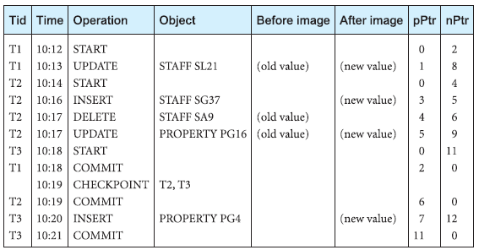
Segment of a log file

Slide 33
Recovery Techniques
Consider two cases:
If the database has been extensively damaged
If the database has not been physically damaged but has become inconsistent

Slide 34
Recovery techniques using deferred update
Using the deferred update recovery protocol, updates are not written to the database until after a transaction has reached its commit point.
Use log file for recovery
Recovery techniques using immediate update
Using the immediate update recovery protocol, updates are applied to the database as they occur without waiting to reach the commit point
Shadow paging

Slide 35
Shadow paging
Shadow paging is a technique used in database systems to provide a consistent view of the database during the execution of transactions and to support efficient crash recovery. It involves maintaining a shadow copy or snapshot of the entire database, which is used for transaction execution, while the actual database remains unchanged.
In shadow paging, the database is divided into fixed-size pages, and a separate page table, known as the shadow page table, is maintained to map logical page numbers to physical page numbers. The shadow page table contains the mapping information for the shadow copy of the database.
Storage overhead

Slide 36
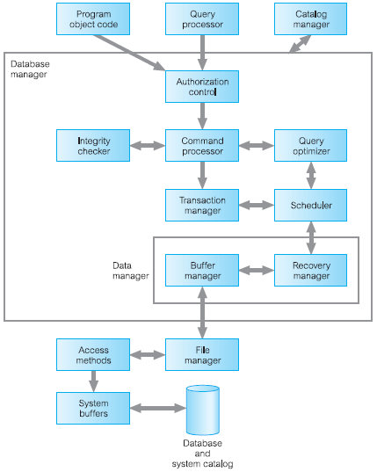

Slide 37
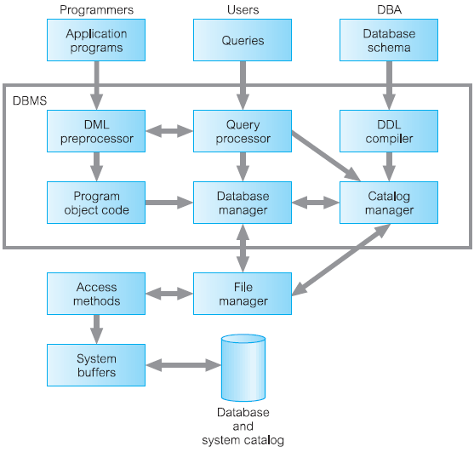
Major components of DBMS

Slide 38
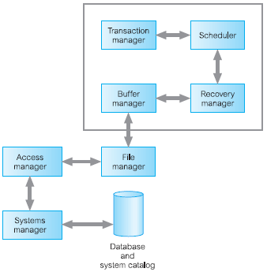
DBMS Transaction subsystem

